Slide 1
Cloud Computing

Slide 2
Outline
Why Cloud Computing?
What is Cloud Computing?
Types of Cloud Computing
Cloud Providers

Slide 3
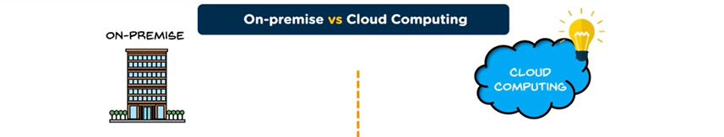
Why Cloud Computing?
Higher pay, less scalability
Allot huge space for servers
Appoint a team for Hardware and software administration
Poor data security
Less chance of data recovery
No automatic updates
Less collaboration
No remote access
Pay for what you use
Scale up= pay more
Scale down= pay less
No server space required
No experts required for hardware and software administration
Better data security
Disaster recovery

Slide 4
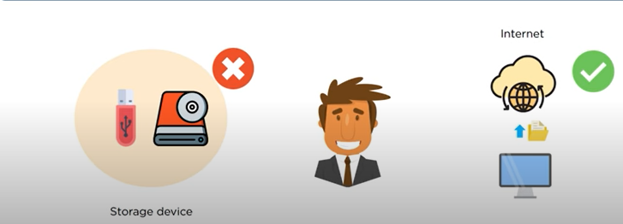
What is cloud Computing?
Cloud computing:
Internet-based computing in which large groups of remote servers are networked so as to allow sharing of data-processing tasks, centralized data storage, and online access to computer services or resources.
Any computer related task that is done entirely on the Internet

Slide 5
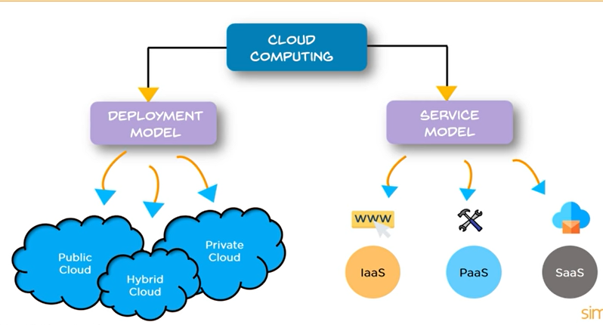
Types of Cloud Computing

Slide 6
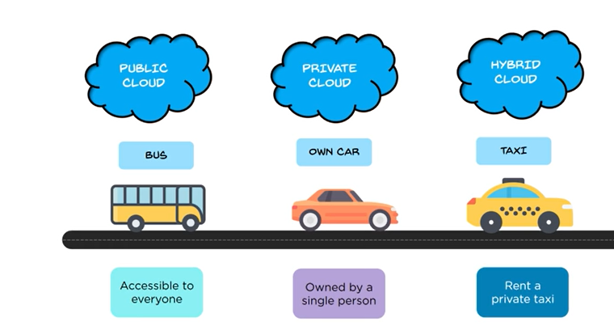
Deployment Model

Slide 7
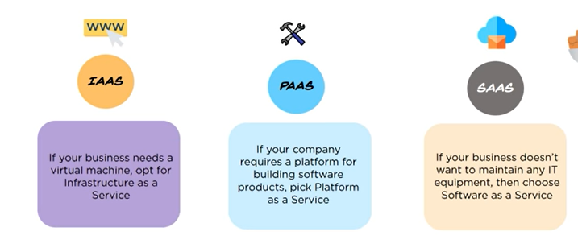
Service Model

Slide 8
IaaS
IaaS is a cloud service that provides basic computing infrastructure
Services are available on PAY-FOR-WHAT-YOU-USE model
IaaS providers include Amazon Web Services, Microsoft Azure and Google Compute Engine
Users: IT Administrators

Slide 9
PaaS
PaaS provides cloud platforms and runtime environments for developing, testing and managing applications
It allows software developers to deploy applications without requiring all related infrastructure
Users: Software Developers

Slide 10
SaaS
In SaaS, cloud provides host and manage the software application on a pay-as-you-go pricing model
All software and hardware are provided and managed by a vendor so you do not have to maintain anything
Users: End Customers

Slide 11
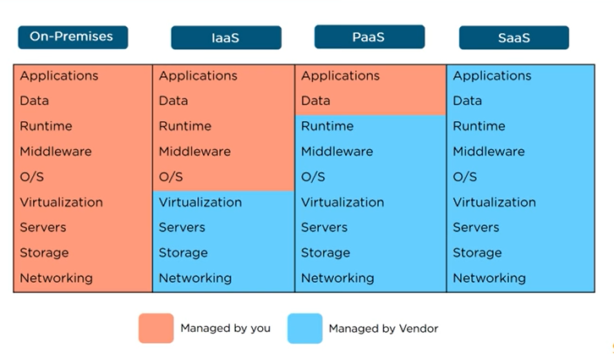
Comparison on types of cloud computing

Slide 12

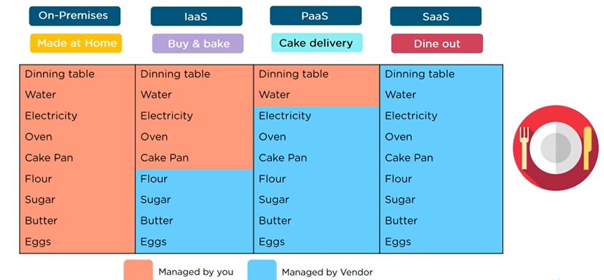
Difference between IaaS, PaaS, SaaS

Slide 13
Cloud Providers
The three leading cloud computing vendors in the infrastructure as a service (IaaS) and platform as a service (PaaS) markets.
Amazon Web Services (AWS)
Microsoft Azure
Google Cloud Platform (GCP)
Each have their own strengths and weaknesses that make them ideal for different use cases.

Slide 14
AWS
Strengths
• Dominant market position • Extensive, mature offerings • Support for large organizations • Extensive training • Global reach
Weaknesses
• Difficult to use • Cost management • Overwhelming options

Slide 15
Microsoft Azure
Strengths
Second largest provider
Integration with Microsoft tools and software
Broad feature set
Hybrid cloud
Support for open source
Weaknesses
Issues with documentation
Incomplete management tooling

Slide 16
Google
Strengths
Designed for cloud-native businesses
Commitment to open source and portability
Deep discounts and flexible contracts
DevOps expertise
Weaknesses
Late entrant to IaaS market
Fewer features and services
Historically not as enterprise focused

Slide 17
Links for cloud vendors
AWS
https://aws.amazon.com/free/?sc_channel=PS&sc_campaign=acquisition_US&sc_publisher=google&sc_medium=cloud_computing_b&sc_content=aws_account_bmm_control_q32016&sc_detail=+aws%20+account&sc_category=cloud_computing&sc_segment=102882724242&sc_matchtype=b&sc_country=US&s_kwcid=AL!4422!3!102882724242!b!!g!!+aws%20+account&ef_id=WcK1-gAAAY@WJOe2:20171208181850:s
Microsoft AZURE—most useful
https://azure.microsoft.com/en-us/developer/students/
Google Cloud
https://techcrunch.com/2017/03/09/googles-cloud-platform-improves-its-free-tier-and-adds-always-free-compute-and-storage-services/

